Slide 1
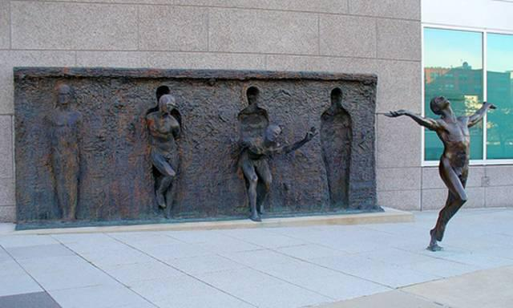
Personal Development & Team Leadership
Prof: Andrew PRIOR
Class 3: Morning-14Oct-2024

Slide 2
Intention today
Recap from last week
Where are we on the course?
More on MBTI and 16 types
Form groups
Exploring the EQ results pentagram – what do your results mean?
Strengths and weaknesses
About ‘human nature’ influence on behavior
Things to do for next week
Learning Log
References & glossary

Slide 3
That’s what we did last week!
Did a short quiz on Goleman video
Reviewed your EQ questionnaire results
Explored how culture influences our behavior
Understood about how much choice we have
Explored preferences & the MBTI personality assessment approach

Slide 4
Comments from Learning Logs
I would appreciate more lively intro, especially since I am somewhat introverted and we are supposed to talk with other people right after:)
There is a lot of talking going on in the back of the classroom while you are lecturing. Which makes it very hard to follow the lecture since they are disturbing.
The back of the class are chatting back and forth all the time and it is very disturbing. Can this be taken care of and mitigated for the next lesson?
I think using a microphone would make it easier to follow the presentations as there is a little bit of noise in the classroom
Maybe explain more the goal of the little group activity because we don't really get the point sometimes, for example the plans for going to the airport or the soccer team, I have no idea what it was for but I guess there is a signification I did not get.

Slide 5
Questions from Learning Logs
I want to know the source of the chart showed in slide number 27 (just in order to do some personal research.)
Could there be more than 16 personalities, maybe different shades of these?
how to know if what we already do is the right thing ? (it's a question that stays in the time and I don't think I'll have an answer in this class and I also don't think I'll have other questions than this one)
how can I better balance thinking and feeling in my decision-making processes?
Can the MBTI preferences be chosen depending on the situation? For example on some situation adopt the feeling strategy and on the other the thinking.
It can be hard to choose only one of the sides when evaluating what type of person you are. And I think it is because I feel that I can act very different depending on the situation. What do you think about this, are we only one "type" of person all the time?
Is it normal that I feel introverted when I am angry and extroverted most of the time?
Is it possible to change ones personality at a deep level? Meaning not just the way you act, but the continues structure of it.
How do I know if I answered the questions right. (E.g. in the EQ questionnaire or MBTI)
What does an MBTI certified professional do?
What does the little -T means after the MBTI type means ?
can you tell us some techniques you use for managing the class? so we are more aware
Does being introverted mean being shy?
How much does it cost to take a real MBTI test?
Is it common to be in the thinking and sensing group at the same time ?
in some cases we are not a pure introvert or extrovert, how to make distinction between these two? maybe make percentage of each one, average or something else
Can a personality be extended (inverse of categorized)?
psychology around how good people self assess
How does the personality eg. the result of 16personalities matter for team leading and HR?
Why our personality comes largely from our genes ?
What positions fit certain personality types?
Which actions/habits could help me to improve my emotional intelligence.
How can I change where I get my energy?

Slide 6
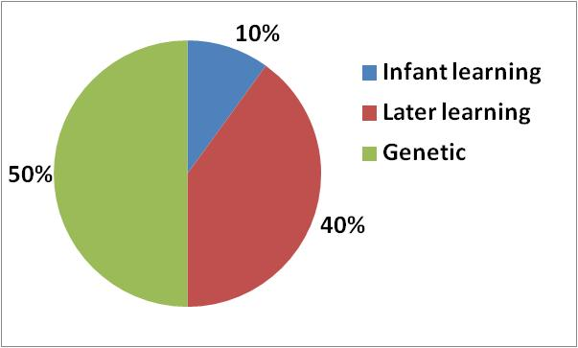
How much choice do we have?
10-30%
40-50%
30-40%
(Rough approximations)
Some references:
https://www.nature.com/articles/s41539-018-0030-0
https://www.ncbi.nlm.nih.gov/pmc/articles/PMC2784897/ and https://www.ncbi.nlm.nih.gov/pmc/articles/PMC3710702/

Slide 7
Assignment for class 3: Explore MBTI questionnaires and types. Find best fit for you
Free online MBTI assessments for example: https://www.16personalities.com
Use them at your own risk. Check out privacy / data policies and what information you give them.
Or official MBTI which is well researched. Find a certified MBTI practitioner (I am certified)
Learn more about your type – see online links about MBTI
https://www.myersbriggs.org/my-mbti-personality-type/myers-briggs-overview/
https://www.themyersbriggs.com/en-US/Resources/MBTI-Shareables

Slide 8
A perspective on behavior
Learn to be mindful of how you are seen by others, and why
The ‘iceberg’ model:
Observable
Behavior
The hidden attributes drive behavior
Culture –learned attitudes & beliefs
Personality - mainly innate/genetic
‘Hidden’
Human nature – innate/genetic
8

Slide 9
Attitudes
Extraversion
Energised by outer world
Judgement
Prefer a planned, decided, orderly way of life
Introversion
Energised by inner world
Perception
Prefer a flexible, spontaneous way of life
Source of energy
S
N
Information gathering
T
F
Decision making
External Life style

Slide 10
External lifestyles
Judging Perceptive
Prefers an organized lifestyle
Prefers a flexible lifestyle
Likes definite order &structure
Likes going with the flow
Prefers to experience life as it happens
Likes to have life under control
Enjoys being decisive
Enjoys being curious, discovering surprises
STOP!!

Slide 11
External lifestyles
Judging Perceptive
1. Lsdakjflafj
2. Aölkdfjlka
3. Aöldkflakf
4. Aökdlkajdf
5. Aölkdf
Likes clear limits and categories
Likes freedom to explore
without limits
Feels comfortable maintaining openness
Feels comfortable establishing closure
Handles deadlines, plans in advance
Meets deadlines by last minute rush
1 2 3 4 5 6 7
8 9 10 11 12 13 14
15 16 17 18 19 20 21
22 23 24 25 26 27 28
29 30 31
J´s may seem demanding, rigid, uptight to P´s
P´s may seem disorganized, messy irresponsible to J´s

Slide 12
Activity for Judging - Perceiving
Where do you stand on this continuum?:
I have to finish my ------------------------- I can play anytime
work, before I play
What do you do on holiday?:
Know what you’re -------------------------- Will find out when
going to do we get there

Slide 13
Which one is your gift?
J P
Judging
Organized
Structure
Control
Decisive
Deliberate
Closure
Plan
Deadlines
Productive
Perceiving
Flexible
Flow
Experience
Curious
Spontaneous
Openness
Wait
Discoveries
Receptive
https://www.youtube.com/watch?v=9TnCgcNQl5Q

Slide 14
Verifying Your Type Preferences
Very Clear Clear Moderate Slight
Slight Moderate Clear Very Clear
Extraversion
Energised by outer world
Sensing
Works with known facts
Thinking
Bases decisions on impersonal analysis and logic
Judgement
Prefer a planned, decided, orderly way of life
Introversion
Energised by inner world iNtuition
Looks for possibilities and relationships
Feeling
Bases decisions on personal values
Perception
Prefers a flexible, spontaneous way of life
Source of energy
Information gathering
Decision making
External Life style
E/I S/N T/F J/P
1. ”Self-Assessment” Type ___E__ ___N___ ____F__ ___P__
2. ”Indicator” Type __E/I__ ___N___ ___T/F__ __J/P__
3. ”Best Fit” Type ____I__ ___N___ ___F___ ___P__

Slide 15
The MBTI assessment? Best fit?

Slide 16
Verifying Your Type Preferences
Very Clear Clear Moderate Slight
Slight Moderate Clear Very Clear
Extraversion
Energised by outer world
Sensing
Works with known facts
Thinking
Bases decisions on impersonal analysis and logic
Judgement
Prefer a planned, decided, orderly way of life
Introversion
Energised by inner world iNtuition
Looks for possibilities and relationships
Feeling
Bases decisions on personal values
Perception
Prefers a flexible, spontaneous way of life
Source of energy
Information gathering
Decision making
External Life style
E/I S/N T/F J/P
1. ”Self-Assessment” Type ___E/I__ ___N___ ____T/F__ ___P__
2. ”Indicator” Type __E/I__ ___N___ ___T/F__ __ P__
3. ”Best Fit” Type ____E__ ___N___ ___F___ __P__

Slide 17
Finding your type
This is about you
Your self-assessment
Your judgement
Your perception about your self
YOU MIGHT HOWEVER BENEFIT OF
Feedback and/or Coaching
That is exactly how I see you as well
I remember when we where doing project X you where asking exactly these type of questions
Well actually I have seldom see´n you acting like that
etc.
Could you give an example of a situation where you acted like that?
If you would be the opposite type, how would you have acted then?
How would your superior, subordinate, colleague assess you?
Is that your type more at home or at work?
etc.
But please remember - you are the best and final judge!!

Slide 18
The Process to find the “best-fit” type
Source 1:
Self Assessment
theory
Source 2:
MBTI Indicator
questionnaire
These help to identify where to start reading!!
ISTJ
10 %
ISFJ
15%
INFJ
50 %
INTJ
20 %
ISTP
30 %
ISFP
20 %
INFP
85 %
INTP
40 %
16 type descriptions
ESTP
40 %
ESFP
30 %
ENFP
80 %
ENTP
70%
ESTJ
25 %
ESFJ
25 %
ENFJ
65 %
ENTJ
30 %
Your type is the one where you find most in common when you read the type description

Slide 19
Characteristics of each type
ISTJ Quiet, serious, earn success through thoroughness & dependability. Practical, matter of fact, realistic and responsible. Decide logically what should be done & works towards it steadily, regardless of distractions. Takes pleasure in making everything orderly and organized – their work, their home and their life. Values traditions and loyalty. | ISFJ Quiet, friendly, responsible and conscientious. Committed and steady in meeting their obligations. Thorough, painstaking & accurate. Loyal, considerate, notice and remember details about people who are important to them, concerned with how others feel. Strive to create an orderly and harmonious environment at work and at home. | INFJ Seeks meaning and connection in ideas, relationships and material possessions. Wants to understand what motivates people and are insightful about others. Conscientious and committed to their firm values. Develops a clear vision about how best to serve the common good. Organized and decisive in implementing their vision | INTJ Have original minds and great drive for implementing their ideas and achieving their goals. Quickly sees patterns in external events and develops long-range explanatory perspectives. When committed, organize a job and carry it through. Skeptical and independent, have high standards of competence and performance for themselves and others
ISTP Tolerant & flexible, quiet observers until a problem appears, then act quickly to find workable solutions. Analyses what makes things work and readily gets through large amounts of data to isolate the core of practical problems. Interested in cause &effect, organize facts using logical principles, value efficiency. | ISFP Quiet, friendly, sensitive and kind. Enjoy the here and now, what going on around them. Likes to have their own space and to work within their own time frame. Loyal & committed to their values and to people who are important to them. Dislikes disagreements and conflicts, do not force their opinions or values onto others. | INFP Idealistic, loyal to their values & to people who are important to them. Want an external life that is congruent with their values. Curious, quick to see possibilities, can be catalysts for implementing ideas. Seeks to understand people and to help them fulfill their potential. Adaptable, flexible and accepting unless a value is threatened | INTP Seek to develop logical explanations for everything that interest them. Theoretical & abstract, interested more in ideas than in social interaction. Quiet, contained flexible and adaptable. Have unusual ability to focus in depth to solve problems in their area of interest. Skeptical, sometimes critical, always analytical.
ESTP Flexible & tolerant, they take the pragmatic approach focused on immediate results. Theories and conceptual explanations bore them – they want to act and energetically to solve the problem. Focus on the here and now, spontaneous, enjoy each moment that they can be active with others. Enjoy material comforts and style. Learn best through doing. | ESFP Outgoing, friendly and accepting. Exuberant lovers of life, people and material comforts. Enjoy working with others to make things happen. Bring common sense and a realistic approach to their work, and make work fun. Flexible and spontaneous, adapt readily to new people and environments. Learn best by trying a new skill with others | ENFP Warmly enthusiastic and imaginative. See life as full of possibilities. Make connections between events and information very quickly, and confidently proceed based on the patterns they see. Want a lot of affirmation from others, and readily give appreciation and support. Spontaneous and flexible, often rely on their ability to improvise and their verbal fluency | ENTP Quick, ingenious, stimulating, alert and outspoken. Resourceful in solving new and challenging problems. Adept at generating conceptual possibilities and then analyzing them strategically. Good at reading other people. Bored by routine, will seldom do the same thing the same way, apt to turn to one new interest after another
ESTJ Practical, realistic, matter-of-fact. Decisive, quickly move to implement decisions. Organize projects and people to get things done, focus on getting results in the most efficient way possible. Takes care of routine details. Have a clear set of logical standards, systematically follow them and want others to also. Forceful in implementing their plans | ESFJ Warm-hearted, conscientious and co-operative. Want harmony in their environment, work with determination to establish it, like to work with others to complete tasks accurately and on time. Loyal, follow through even in small matters. Notice what others need in their day-to-day live and try to provide it. Want to be appreciated for who they are and foe what they contribute | ENFJ Warm, empathetic, responsive and responsible. Highly attuned to the emotions, needs and motivations of others. Find potential in everyone, want to help others fulfill their potential. May act as catalysts for individual and group growth. Loyal, responsive to praise, & criticism. Sociable, facilitate others in a group, and provide inspiring leadership | ENTJ Frank, decisive, assume leadership readily. Quickly see illogical and inefficient procedures and polices, develop and implement comprehensive systems to solve organizational problems. Enjoy long term planning and goal setting. Usually well informed, well read, enjoy expanding their knowledge and passing it on to others. Forceful in presenting their ideas
https://www.myersbriggs.org/my-mbti-personality-type/the-16-mbti-personality-types

Slide 20
Type Alike Groups
Introduce yourselves and write your name of the A4 paper (% best fit)
What does it feel like to be in the type alike group? What is your groups’ dominant function?
Is it introverted or extraverted?
How does the summary of your type resonate with you? How well does it fit?

Slide 21
Break of 15’

Slide 22
Valuing Differences
E / I -groups:
What do you really admire about the other group?
What baffles you about the other group?
What questions do you have for the other group?
“If it is important to extraverts, they will show it. If it is important to introverts, they will often hide it, at least until they are sure it will be treated with respect.”
LaVonne Neff, One of a Kind

Slide 23
Type Dynamics
Mental Functions
S - Gathering of Information - N
T - Taking Decisions - F
Dominant Function
For each type, one of the four letters (S,N,T,F) takes the lead or is the most preferred, the most conscious, most differentiated, most developed, the governing force
No person can be effective or consistent without one of the functions taking lead
People use their dominant function most in their favourite world (E / I)
Auxiliary Function
The other function in the type code, the second in importance
Helps and supports the dominant function
If dominant is information gathering then auxiliary is decision making and vice versa
Dominant and auxiliary functions are used in opposite worlds (I / E)
Tertiary Function
Not one of our preferred functions, usually much less developed than the first two but will be used every now and then
Opposite to the auxiliary function
Inferior Function
Opposite to the dominant function and is used in the opposite world
Assumed to be nearest to the unconscious, takes most energy to use
The inferior function is most likely to show itself when people are under stress, ill, or otherwise not acting like themselves
Extraversion
Introversion

Slide 24
Awareness of Mental Functions
Examples:
INFP => Fi, Ne, Si, Te
INTJ => Ni, Te, Fi, Se
Most Conscious
D
dominant
Fi
Ne
A
auxiliary
Si/e
T
tertiary
Te
Least Conscious
I
inferior
Ni
Te
Fi/e
Individuation Process
Good Type Development
Finding Balance in Life
Se

Slide 25
According to Jung’s theory there are 8 mental Functions
Extraverted (External, doing)
Sensing = Experiencing
iNtuition = Seeing relationships, possibilities
Thinking = Organizing
Feeling = Considering others
Introverted (Internal, reflecting)
Sensing = Recalling
iNtuition = Foreseeing implications
Thinking = Analyzing
Feeling = Evaluating importance

Slide 26
Sensing
Extraverted Se
Experiencing and noticing the physical world, scanning for visible reactions and relevant data
What is really happening? What are the facts of the situation? What can I do with this now?
There is always more to be experienced, and opportunities don't last.
Take a moment and took around you. Notice the smells, the sounds, and the sights. What sounds do you notice in the background right now? Touch something and feel its texture. Focus on the variety of stimulations, allowing yourself to become absorbed in them. If something "excites" the senses, stay with that as Long as it lasts.
Introverted Si
Recalling past experiences, remembering detailed data and what it is Iinked to
What have I already learned that I can build on? What resources and materials are available? What practical use does this have?
There is always s a comparison to be made, and if it is familiar it is to be trusted
Now as you look around, allow something you see to trigger an image of something you've experienced before and let the recollections flow for a while. Pause and notice how far a field you are from the external stimulus that started the recall.

Slide 27
iNtuition
Extraverted Ne
Inferring relationships, noticing threads of meaning, and scanning for what could be
What inferences can I make? What meanings am I perceiving? What hypotheses can I generate?
There are always other perspectives and new meanings to discover
Look around you and allow something you see in your environment to trigger a new idea or possibility. Or think of someone in your life right now and remember something he or she said or did recently or a look on someone's face. What do you suppose he or she means (meant) by that?
Introverted Ni
Foreseeing implications, conceptualizing, and having images of the future or profound meaning
What are the implications for the future? What are the concepts? What is the greater purpose?
There is always a future to realize and a significance to be revealed
Look around you again and all yourself to be triggered into realizing the implications of doing something with an object you see. I (Again, be patient. A perception of the future > may not come quickly; just be alert to its subtle presence and it will surface.)

Slide 28
Thinking
Extraverted Te
Organizing, segmenting, sorting, and applying logic and criteria
How can I structure and organize my learning? What is the sequence and arrangement of what I am learning? What is the logic behind what I am learning?
Everything can be logical, structured and organized
Look around you again and find some items to organize in the room. File some papers. Sort some mail. Organize something or try to under¬stand the system of Logic someone else used!
Introverted Ti
Analyzing, categorizing, and figuring out how something works
What principles do I need to learn? What models can I fit the learning into? What techniques or approaches can I apply?
Everything can be explained and understood in terms of how it works.
Look around you again and name some of the objects in the room. What classes or categories are they members of? As you classify them, check against the objective categories you hold mentally.

Slide 29
Feeling
Extraverted Fe
Considering others and responding to them
Who can I connect with, or relate to in order to learn better? Who can I help with this learning? How can I use this to improve my relationships?
Everything can be considered in terms of how it affects others.
Ask yourself whose birthdays are coming soon. What do you think of to get for them? What do they Like? Would they Like a surprise party or a singing telegram? Should you get them a sentimental card or a humorous card? What Would they most enjoy?
Introverted Fi
Evaluating importance and maintaining congruence
What is really important here? What is of value to me, and what do I want out of this? Who is good to learn from?
Everything can be in harmony or congruence.
When you look around what do you see that you Like or dislike? What is most important for you or your family, friends, or co-workers? What would be most important (for them) to do next?

Slide 30
Type Alike Groups
If we could use only a few words and phrases to tell the rest of the world about our type, which ones would you choose?
Write on an A3 paper. Consider what is your personality type dominant and auxiliary functions? What strengths do you share?

Slide 31
Understanding Different “quadrants” of Personality Types
Sensing
Intuition
THOUGHTFUL
Introvert
IS
Thoughtful
Realist
IN
Thoughtful
Innovator
REALIST
INNOVATOR
ES
Action- Oriented
Realist
EN
Action- Oriented
Innovator
Extrovert
ACTION-ORIENTED
Let’s explore each of these four (4) types in more detail.

Slide 32
IS Thoughtful Realist “If it isn’t broke don’t fix it!”
Focus
Practical considerations, continuity
Wants
See difference between what should be preserved
What could be changed
Concerned
With what needs to be kept
Dislikes
Brainstorming, being rushed, empty promises
Irritates others by:
Wanting to take their time over things
Looking into the detail
Being unwilling to embrace change for change’s sake
You can help them by:
Ensuring that something stays the same
Giving them plenty of time to adjust
Giving them relevant things to read and think about
Notes:
INSTRUCTOR NOTES: Thoughtful Realist
Leadership: Through attention to what needs doing
Work environment: Quiet, reflective, thoughtful hours that are regular and scheduled
Administrative focus: procedures are followed and exceptions noted
Reliance on written words and policies
Individual focus: Practical considerations
Learning focus: What can be applied to current or anticipated needs
Learning process: By reading and observing
Organizational Focus: Continuity, such as in administration and accounting
Change: Comes from seeing the difference between what should be preserved and what could be changed
Motto: ‘Let’s keep it ‘

Slide 33
IN Thoughtful Innovator “Let’s think ahead!”
Irritates others by:
Taking too much time to think things through
Wanting to know how everything fits together
Planning at the expense of doing
You can help them by:
Ensuring big picture makes sense
Giving them time and space to think things through
Making sure there’s room for new ideas and strategies
Focus
Thoughts, Ideals, Vision
Wants
Develop internal vision of future which “stacks up”
Concerned
With new ideas & theories about what needs doing
Dislikes
Instruction manuals, training courses, things that don’t make sense
Notes:
INSTRUCTOR NOTES: Thoughtful innovator
Leadership: Through ideas to what needs doing
Work environment: Quiet, reflective, thoughtful; Hours that can be sporadic
Quasi academic focus: independent of procedures
Reliance on written words and research
Individual focus: Intangible thoughts and ideals
Learning focus: Learning for learning’s sake: for the joy of creating something new
Learning process: By reading and reflecting
Organisational Focus: Vision, such as in research and development
Change: Comes internally from their visions of the future
Motto: 'Let's think about it differently’

Slide 34
ES Action-Oriented Realist “Let’s just do it!”
Focus
Practical actions, results
Wants
Get things to run more effectively and efficiently
Concerned
With improving results
Dislikes
Reviews, theoretical discourse, long e-mails
Irritates others by:
Starting without thinking
Ignoring interpersonal niceties
Bulldozing things through
You can help them by:
Giving them some practical first steps to get on with
Establishing clear targets
Setting a focused direction
Notes:
INSTRUCTOR NOTES: Action oriented Realist
Leadership: Through action, doing
Work environment: Energetic , outgoing, active; Hours that are regular and scheduled
Implementation focus: time is spent out and about doing what works
Reliance on spoken words leading to action
Individual focus: Practical actions
Learning focus: What is relevant that will help me do my job better now
Learning process: By doing
Organisational Focus: Results, in sales, production, manufacturing
Change: Comes from getting things to run more effectively and efficiently
Motto: ‘Let’s do it’

Slide 35
EN Action-Oriented Innovator “Let’s change it!”
Focus
Systems, relationships, change
Wants
Talk with others, be creative and try something different
Concerned
With putting new ideas into practice
Dislikes
Small chunks of disconnected work, long periods of reflection, repetition, lack of vision
Irritates others by:
Wanting to change things quickly
Moving from change initiative to another
Having too much enthusiasm for change rather than consolidation
You can help them by:
Allowing them to take charge of a significant area of work
Talking things through with them enthusiastically
Tapping into their creativity
Notes:
INSTRUCTOR NOTES: Action Oriented Innovator
Leadership: Through enthusiasm
Work environment: Energetic, outgoing, active; Hours that can be sporadic with bursts of energy
Cutting edge focus: time is spent out there trying new things
Reliance on spoken words leading to possibilities
Individual focus: Systems and relationships
Learning focus: What is engaging and fun that feeds my creativity and insight
Learning process: By talking/ acting through ideas
Organisational Focus: Change as in marketing, promotions and new ventures
Change: Comes from trying something different or novel
Motto: ‘Let’s change it’

Slide 36
Applied to Different Leaders Preferences for Change, Development and Learning? How does this apply to you? How might we handle conflicts between different types?
Thoughtful Realist
Leadership through attention to what needs doing
Cautious and careful about change
“Let’s keep it!”
Thoughtful Innovator
Leadership through ideas about what needs doing
Plan and generate ideas and visions
“Let’s think about it!”
Action-Oriented Realist Leadership through action, doing
Energy and enthusiasm to get things done
“Let’s do it!”
Action-Oriented Innovator
Leadership through enthusiasm
Will be wanting to move into new areas and soon….!
“Let’s change it!”
Notes:
INSTRUCTOR Notes: Take 10 minutes to discuss where they might fall in this quadrant, particularly when dealing with conflicts between different types.
Key question is: How do you leverage these different preferences through change and what do you need to watch out for?
Key points:
Play to people’s strengths
Communicate with people in a way that that type can understand
Maximise the potential synergies between different types

Slide 37
Quadrants Lens & Change/Learning
Thoughtful Realist (IS)
Like to test their ideas to see whether they
are supported by the facts
Want to deal with practical, concrete
information in a careful and unhurried way
Prefer organisational continuity and tend to
be to most change resistant of the quadrants
Thoughtful Innovator (IN)
Do their best work in theoretical fields
where ideas and depth of understanding are
needed
Value knowledge for its own sake
Prefer an environment that is focused on the
future vision
Least practical of the types
Action Oriented Realist (ES)
Want to carry out practical tasks
Prefer work environment were realistic,
down to earth tasks and problems are managed
Prefer an organisation which focus on results
relating to people, data or things
Most practical of all the types
Action Oriented Innovator (EN)
Value change, see possibilities as a key
aspect of their work
Like to be challenged and to challenge others
Wide range of interests and willing to work
with systems or relationships
Favourite organisation one which encourages
creativity, challenge and change
Most change oriented of the quadrants
Source: Introduction to type in organisations

Slide 38
Forming diverse learning groups
Self organize (with some help from me?) to create 8 groups of 7-8 people
Challenge How to make your group as diverse as possible
National culture
Male - Female
MBTI type

Slide 39
About the ‘human nature’ aspect of behavior

Slide 40
Reminder: A perspective on behavior
Learn to be mindful of how you are seen by others, and why
The ‘iceberg’ model:
Observable
Behavior
The hidden attributes drive behavior
Culture –learned attitudes & beliefs
Personality - mainly innate/genetic
‘Hidden’
Human nature – innate/genetic
40

Slide 41
So, assignments for next class:
Watch SINEK video; quick quiz next class
Create a communication channel for your learning group (WhatsApp?)
Organize your first learning group meeting to get to know one another better
Create a poster => Who are we as a group? Different personality types, nationalities, mother tongues and male/female. Create a name (or identity) for your group. Ready to present for next class.
Personal tasks assignment in moodle:
Your personal development plan for the course. Take into account the data from your individual EQ and personality self assessments and your knowledge about culture.

Slide 42
Learning Log

Slide 43
Appendix Additional slides if needed

Slide 44
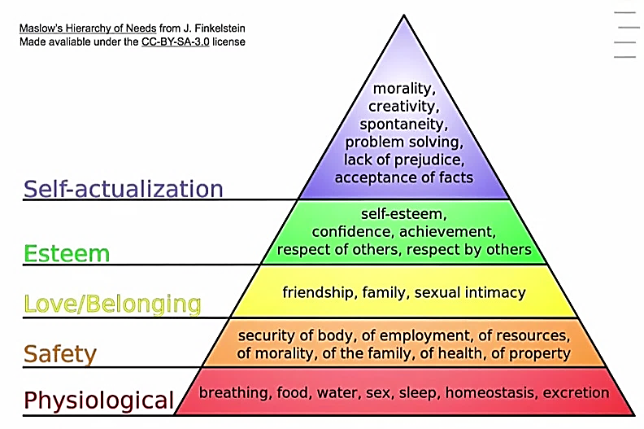
Maslow’s Hierarchy of Needs
Original source: Abraham Maslow in his 1943 paper "A Theory of Human Motivation" published in Psychological Review
Notes:
Maslow: Research what makes people satisfied? Healthy people! Like Albert Eistein! 1% of most satisfied graduates in the USA. That’s how her created his model.
The basic idea is that we are motivated to satisfy certain needs. The physiological being the most important for human survival. If we don’t have these we die
Once we have those satisfied we can focus our attention, our motivation on other higher level needs.
Our motivation is dynamic. Usually have a dominant need, general needs, relative (in the moment needs)
When satisfies needs, feel healthy, well
Think of a situation when you needed to breath, or needed water or sleep etc
What did you feel, what emotions were activated, how did you behave? What did you do, say, tone of voice…..when your really needed those things.
Fight (overcome obstacles)
Now for the next level, when satisfied feel safe, relaxed, secure. Now think of a situation when you needed safety? Maybe you didn’t have a job? Or no place to sleep for the night? Maybe you were very ill or someone broke into your house? What did you feel, what emotions were activated, how did you behave? What did you do, say, tone of voice…..when your really needed those things? Fight/Flight response? Anxiety?
=> People who have suffered from lack of physical and psychological safety in war, on in a dysfunctional family - violence, sexual abuse…or even a car crash can suffer from POST_TRAUMATIC STRESS DISORDER (PTDS) – Big issues with veterans….high suicide rate
Now for the next level, when satisfied we feel joy, happy, excited, sexy, loved, close, cared for, open, sacrifice ….think of a situation when you lost a friend or loved one. What emotions, behaviors? Shock, Anger, Fear, Sadness,
Jealousy / Envy / Guilt => Complex emotions
Now for the next level, when satisfied we feel confident, competent, self- assured, strong, respected, pride “I am great”, sense of achievement, estatic….think of a situation when your self esteem was lost. Someone did not respect you? How did you feel? Angry? Sad? Fear, Shame? Guilt? Jealousy? Or when you failed? You did not achieve what you wanted? Maybe you found out that you were not as good as you thought? Some weakness? Confidence was broken….how did you feel?
Now for the next level, when satisfies we feel, joy, wonder, enthusiasm, curiosity, creative, We can do it”….think of a situation when you had to do something that you thought was wrong? Shame, guilt? Fear, Anger, Sadness
Or when you couldn’t accept the facts because of your beliefs? Or when you found out that you had a prejudice? Muslims better than Christians? Buddhists better than Hindus. Arians are the master race? Women should stay at home with the kids?
What if you are not solving problems relates to our world, poverty, human rights, equity, pollution, global climate change, reduction of biodiversity, loss of species, how are sentient beings (animals) are treated by humans?
What if you can’t be yourself? To realize your potential?
We need to satisfy needs to be healthy human beings. We need to respect these needs for ourselves and others to have healthy families, communities and organisations

Slide 45
MBTI – function preferences & communication
S
F
1
1
F
3
2
T
S
3
2
N
4
4
N
T
ISTJ
Si, Te, Fi, Ne
INFP
Fi, Ne, Si, Te

Slide 46
MBTI – function preferences & communication
F
N
2
1
S
4
1
N
T
3
2
F
3
4
T
S
ENFP
Ne, Fi, Te, Si
INFJ
Ni, Fe, Ti, Se

Slide 47
Temperament Lens - summary of characteristics
SJ=Gardian NF= Idealist
SP=Artisan NT= Rational
NF´s
NT´s
Leader
Traditionalist, stabiliser, consolidator; works from a sense of responsibility and loyalty
Culture guard, provide
Leader
Catalyst, spokesperson, energiser; works by interacting with people about values and inspirations
Culture
humanist, meaningful
Need
authenticity
Motto
„To thine own self be true“
Leader
Visionary, architect of systems, builder; works on ideas with ingenuity and logic
Culture
visionary, pioneer
Need
competence
Motto
„Be excellent in all things“
SJ´s
Leader
Trouble shooter, negotiator, fire fighter; works via action with cleverness and timeliness
Culture act, improvise
Need
freedom
Motto
„Eat, drink and be merry“
SP´s
Need
belonging
Motto
„Early to bed, early to rise“
SJ´s
Source: Introduction to type in organisations

Slide 48
Career Interests
People who
prefer->
ST
SF
NF
NT
Focus on:
Facts
Facts
Possibilities
Possibilities
Handles these by applying
Objective analysis and experience
Personal warmth, concern for others
Attention to people´s potential
Theoretical concepts and systems
Thus tend to become:
Practical and analytical
Sympathetic and friendly
Insightful and enthusiastic
Logical and analytical
Find scope for their interests in
Technical skills with objects and facts
Practical help and services for people
Understanding and encouraging people
Theoretical and technical frameworks
For example:
Applied Science
Business
Administration
Banking
Law enforcement
Production
Construction
Health care
Community service
Teaching
Supervision
Religious service
Support services
Sales
Psychology
Human resources
Teaching
Research
Literature
Religious service
Health care
Art and music
Physical science
Research
Management
Computers
Law
Engineering
Technical work
Source: Introduction to type. Isabel Briggs Myers

Slide 49
FYI summary of engineering school students by types
ISTJ | ISFJ | INFJ | INTJ |  | IJ's | I-Types
16% | 5% | 3% | 9% |  | 33%
ISTP | ISFP | INFP | INTP |  | IP's | 54%
6% | 3% | 4% | 8% |  | 21%
ESTP | ESFP | ENFP | ENTP |  | EP's | E-types
4% | 2% | 4% | 7% |  | 18%
ESTJ | ESFJ | ENFJ | ENTJ |  | EJ's | 46%
13% | 4% | 2% | 9% |  | 28%
ST 's | SF's | NF's | NT's |  | T-types | F-types
40% | 13% | 13% | 35% |  | 74% | 26%
 |  |  |  |  | J-types | P-types
S-types | 53% | N-types | 47% |  | 61% | 39%
Source: All students in the American Society for Engineering Education 1981-1986, 3,784 students

Slide 50

So, what else can we do to improve our self-awareness?
Introducing the Jo Hari window

Slide 51
Helping you understand yourself
Group task: Discuss, complete the matrix, and define the dimensions
Known by me & known by others
?
?
?

Slide 52
Jo Hari Window
Helping you understand yourself
Known
by the self
Unknown
by the self
Solution?
Known
by others
Open
(arena)
Blind
spot
Self Exposure
Unknown
by others
Hidden
(behind wall)
Unknown
http://en.wikipedia.org/wiki/Johari_window

Slide 53
Jo Hari Window
Known
by the self
Unknown
by the self
Known
by others
Open
(arena)
Blind
spot
Self Exposure
Unknown
by others
Hidden
(behind wall)
Un-known

Slide 54
Opening up Exercise – Two truths, one Lies? (20’)
In your groups:
Each person in turn tells the others three things about themselves: two things that are true, one that is a lie
Others vote on which is the lie
Speaker identifies which is the lie
Take turns

Slide 55
Getting feedback
In your group
Take it in turns to get feedback. Ask: “When I was doing the two truths, one lie exercise could you tell when I was lying: body language, how I told the story, tone of voice, eye movement?”
Listen carefully to the responses: try to learn something about yourself that you did not know before.

Slide 56
Sharing strengths & weaknesses
Working alone, reflect on your MBTI self-assessment
Think about your personality gifts, strengths & weaknesses (5 minutes)
In your group, by pairs
Take it in turns to share your results, what you learned, your strengths & weaknesses (5 minutes each)
Listen carefully to the speaker – acknowledge what they are saying, ask for clarification, but don’t comment

Slide 57
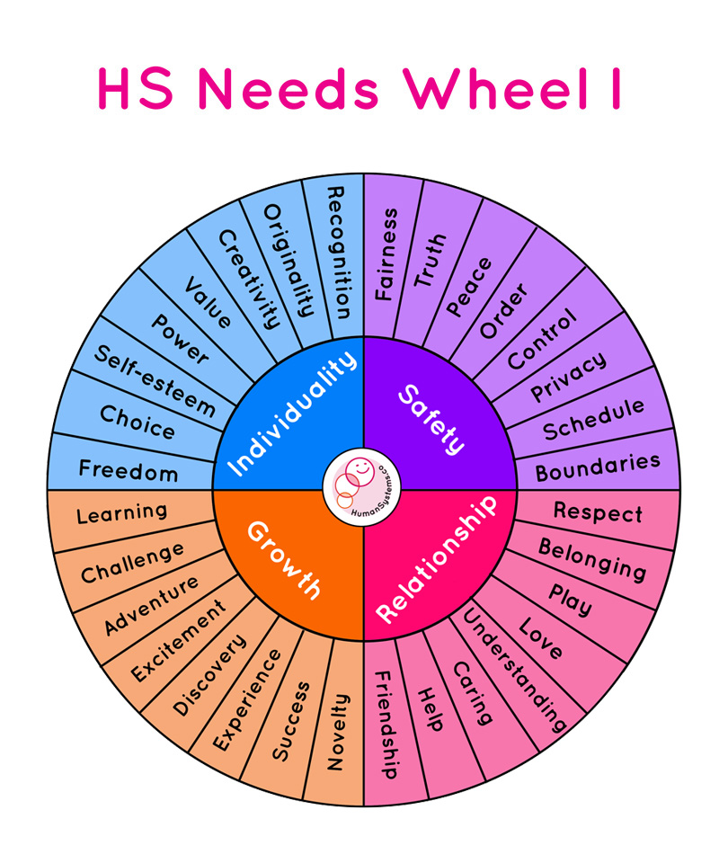
Human Needs:
https://humansystems.co/emotionwheels/

